Slide 1

Who decides how successful you can be at school?
Notes:
Explain
- John Hattie is a University Professor who teaches teachers how to teach
- He did a longitude study of 20 years (4 groups of students going through high school)
- Discovered some very interesting things about what makes a successful student

Slide 2
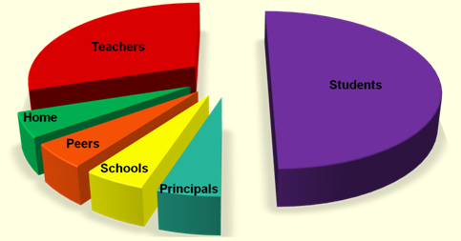
Who decides how successful you can be at school?
Principal – Home – Student (You) – Peers (Friends) – School – Teacher
Notes:
Explain:
- Professor Hattie first looked at who decides your success at school
- Explain pie graph
Do:
- TPS which one is correct
- Tally below vote for each pair

Slide 3
Who decides how successful you can be at school?
You are the most
powerful person in
your life
Principal – Home – Student (You) – Peers (Friends) – School – Teacher
Notes:
Explain
-Professor Hattie found that it does not matter where you come from, what school you go to. So long as you have good teacher then your success is really up to you.

Slide 4
What decides how successful you can be at school?
Intelligence Effort Talent
Notes:
Activity
TPS which one is correct
Tally below vote for each pair

Slide 5
What decides how successful you can be at school?
Intelligence EFFORT Talent
Notes:
Explain
- Professor Hattie found that while Intelligence and Talent do help students they do not guarantee success.
- Both can ‘run out’ and then it is down to you choosing to put in the hard yards.
Question
- What is effort?
Do
- Write any answers on board

Slide 6

EFFORT is when you CHOOSE to
on your work
Notes:
Explain
-Effort is you choosing to focus on the work rather than focusing on a friend, a game on your laptop, a message on your phone or the weather outside.

Slide 7
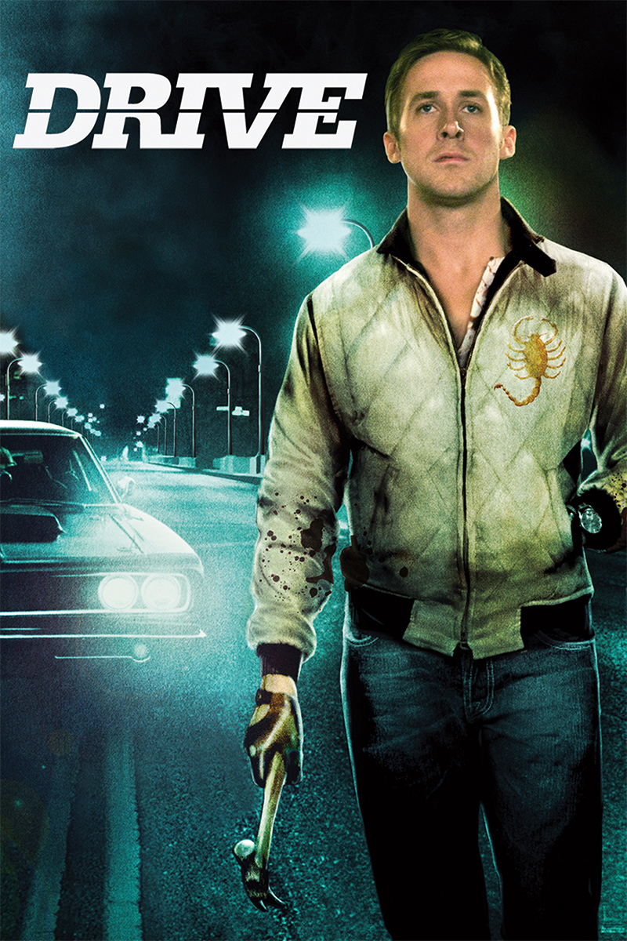
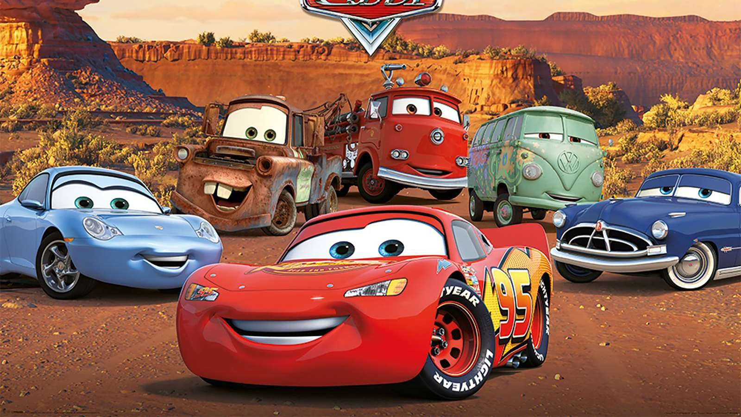
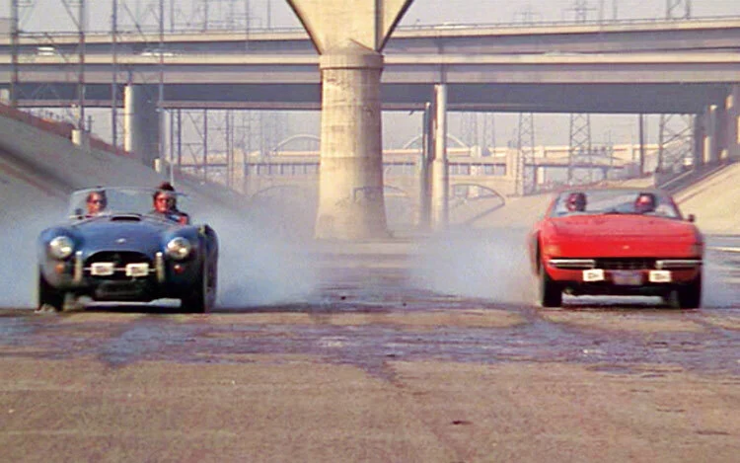
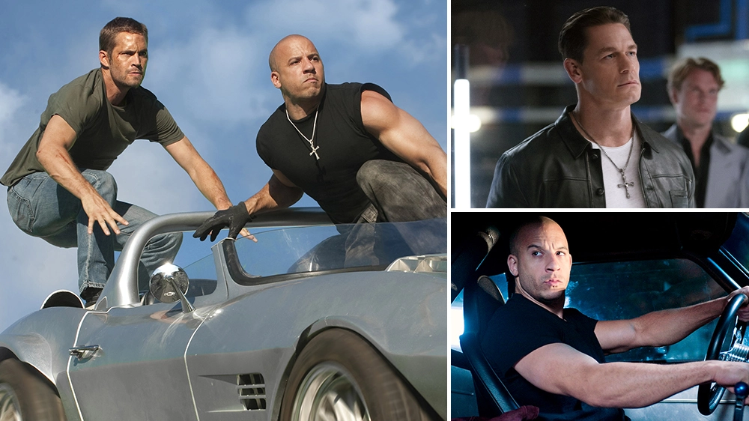
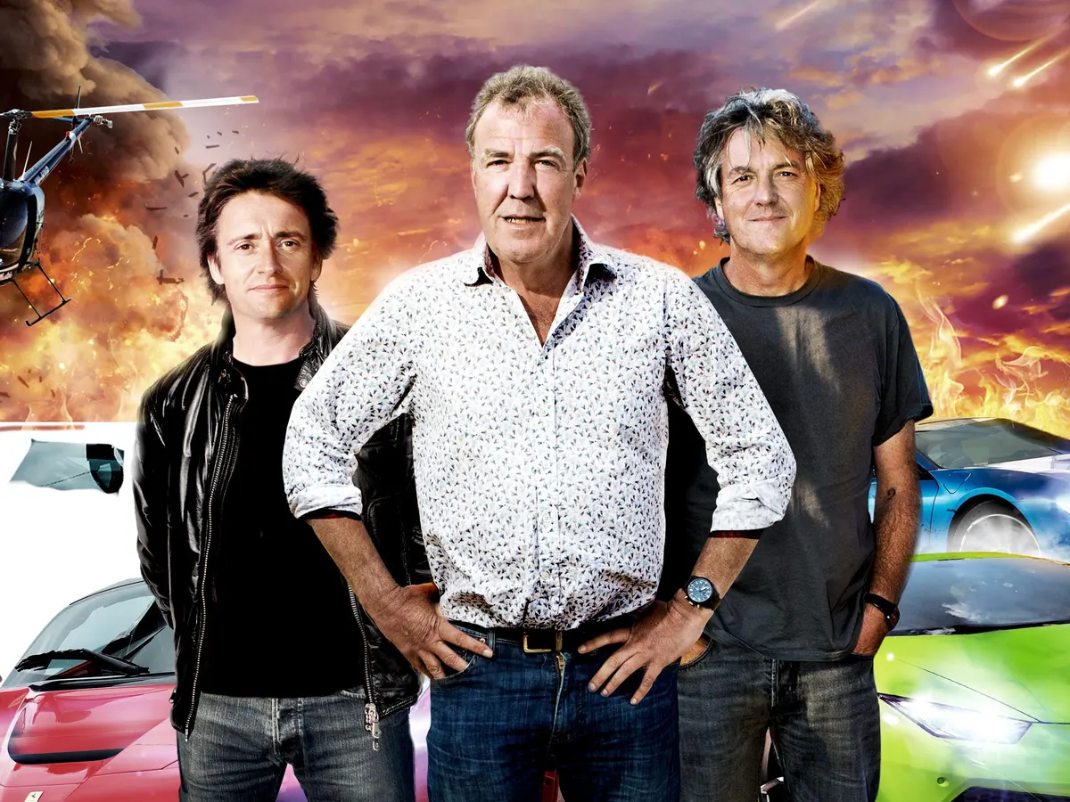
Guess the Car Movie
4.
1
3.
5.
2.
Notes:
Drive
2. Fast and Furious
Greece
Cars
Top Gear

Slide 8

Why are Road Movies so popular?
Road films tend to focus more on characters' internal conflicts and transformations, based on their feelings as they experience new realities. They go on an internal and literal journey of self discovery
Cars are a status symbol –they can make you look cool or sexy, powerful
Which aspects could also apply to learning to drive and getting your own car?
road movies mobilize a dynamic cinematic spectacle of movement and speed (can use the camera/cinematography in new and interesting ways)
Characters have a larger playing field –they can go anywhere, see anything –opens up the world

Slide 9
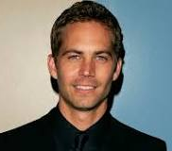


Do these movies/TV shows promote reckless driving??
How did Paul Walker die and when?
On November 30, 2013, at approximately 3:30 p.m.
Walker was involved in a single-vehicle car crash with his friend Roger Rodas. He was 40.
He was driving in Santa Clarita, California at a speed of over 100 mph in a 45 mph

Slide 10

Hollywood actor James Dean was killed at age 24 in an auto accident on September 30, 1955, near Cholame, California

Slide 11
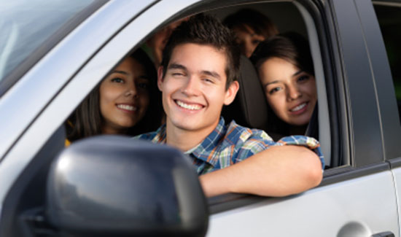
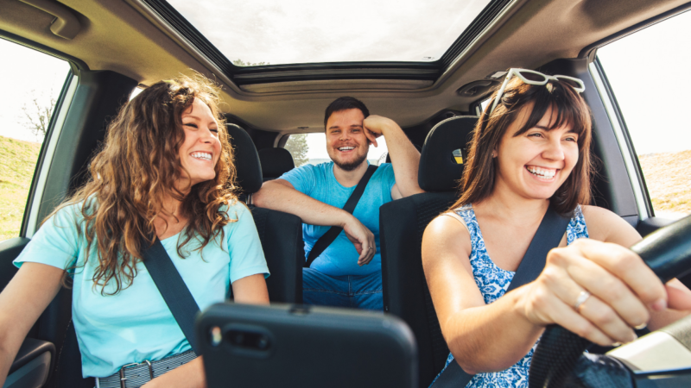

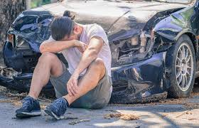
TEENAGERS,
DECISION MAKING
and
CONSEQUENCES
Notes:
Explain
We going to study different texts to examine how and why teens are represented in films and novels. One of the themes we have looked at this year and is a key theme in the novel is the consequences of car accidents.
Question
Which image do you mostly identify with? Why?
Which image do you think novels and films mostly identify teens as? Why? (consider the purpose of non-fiction texts)

Slide 12
Plot Summary
The Story of Tom Brennan is a 2005 novel for young adults by Australian author J.C. Burke. Set in a modern-day Australian town, it chronicles a year in the life of Tom Brennan, a seventeen-year-old football prodigy. After Tom’s brother, Daniel, has a drunk driving accident that results in two innocent people’s deaths, his family is forced to move to a new town. The novel shows the personal transformation that Tom undergoes as he processes a tragedy that he never dreamed would affect him, and shows how the Brennan family as a whole adapts to their new life. The novel is a staple in Australian high school literature curricula, though its status as such has been contested due to its inclusion of topics such as alcohol, mental illness, and crime. The Story of Tom Brennan has been honored as one of the best pieces of Australian young adult fiction by the Children’s Book Council of Australia.

Slide 13
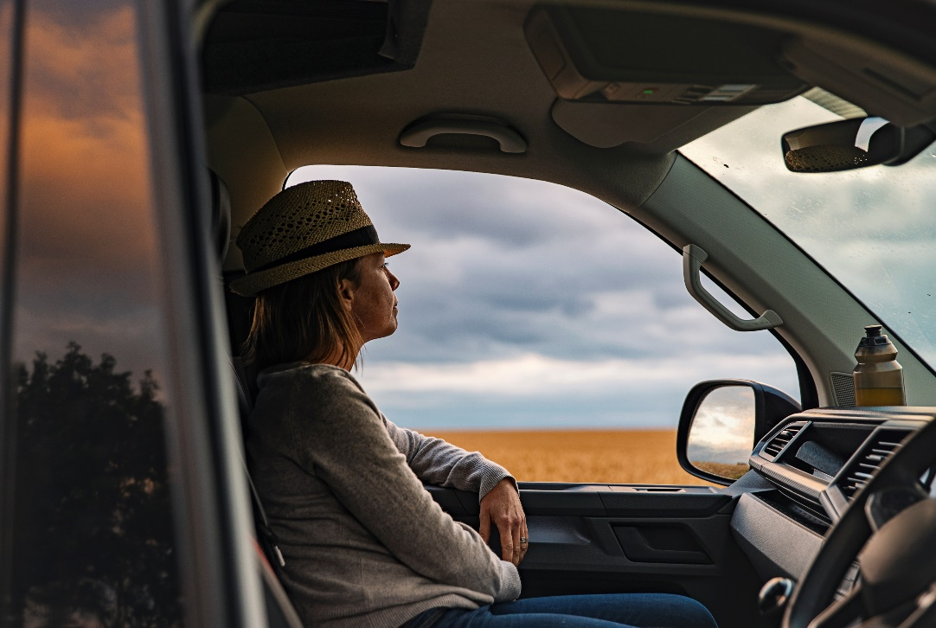
Risk & Responsibility
What age do you get your full license in Western Australia?
To progress to your full driver's licence in WA, you must be at least 19 years old and have held your provisional licence (red and green Ps) for periods adding up to 2 years
From a young person’s perspective, are these rules reasonable? Could they be changed in anyway?
What if you live in a remote area, should there be different rules to the city?
You can apply for a car or motorbike learner's permit from age 16 and a moped learner's permit from age 15½.

Slide 14
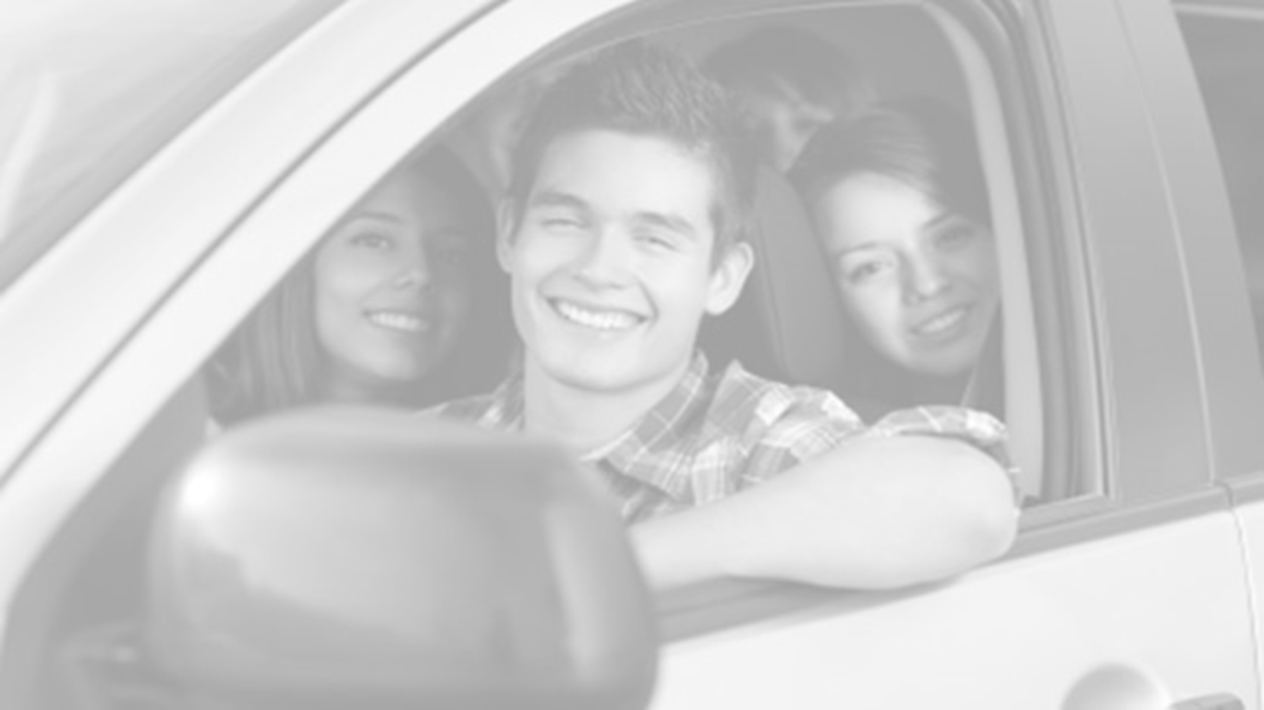
Worldwide, what is the leading cause of death of 16 to 19 year olds?
Class’ opinion | Statistical facts
Notes:
Activity:
Collect student’s opinions

Slide 15

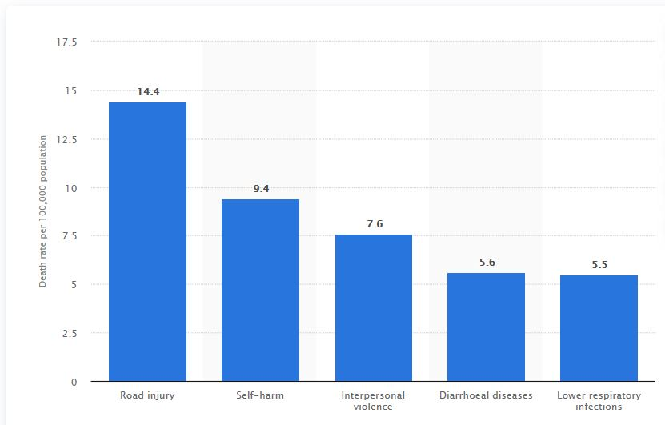
Worldwide, what is the leading cause of death of 16 to 19 year olds?
Class’ opinion | Statistical facts
 | Road injuries emerged as the leading cause of global deaths among adolescents aged 15 to 19 years with a death rate of 14.4 per 100,000 population. https://www.statista.com/statistics/708766/leading-causes-of-death-ages-15-to-19-years-globally/
Notes:
Explain:
Deaths involving land transportation (cars, bikes, buggies, etc), on road and off road, are the leading causes of death for older teenagers.
Question:
Why do you think road injuries might be the leading cause of death? (Consider role of new relationships, legal age of drinking and driving as a newly acquired skill)
Explain:
The three leading causes of deaths (car accidents, suicide and fights) for older adolescents are often categorized together as accidental or unintentional injuries.
Question:
Why do you think these three are categorized together? (consider the role of new relationships and legal age of drinking)

Slide 16
What age group in Australia do you think is the most at risk of being involved in a motor vehicle accident?
Class’ opinion | Statistical facts
Notes:
Activity:
Collect student opinions

Slide 17
What age group in Australia do you think is the most at risk of being involved in a motor vehicle accident?
Class’ opinion | Statistical facts
 | Despite a dramatic reduction in accidents and deaths over the past decade, drivers between the ages 18 – 25 are the most at risk in being in a motor accident. Under 25s are more likely to drink alcohol and drive, drive while fatigued, ignore speed restrictions, become distracted and own aging vehicles with poor crash safety performance. https://www.finder.com.au/young-drivers-nsw-most-at-risk-most-dangerous
Notes:
Explain:
Statistical information often appears to be saying that age groups such as the 40-64 age group are more likely to have accidents or die in car crashes. However, when the amount of people in each age group is accounted for, it is evident that the under 25 group is most at risk. This is reflected in high insurance premiums for drivers under 25.
Question:
Why do you think under 25s are more likely to drink alcohol and drive, drive while fatigued, ignore speed restrictions and become distracted? (Consider developmental progress – frontal cortex not fully wired until 25; natural tendency for young adults to learn about themselves and the world by risk taking/pushing boundaries)

Slide 18
If you are a teenager on your P plates how much more likely is it that you will crash, compared to other drivers?
Class’ opinion | Statistical facts
Notes:
Activity:
Collect student opinions

Slide 19
If you are a teenager on your P plates how much more likely is it that you will crash, compared to other drivers?
Class’ opinion | Statistical facts
 | Drivers on their P’s are 30 times more likely to crash than other drivers (including drivers on their L plates). P plate drivers are at greatest risk of crashing or being injured in the first six to twelve months of probationary driving. https://www.tac.vic.gov.au/road-safety/safe-driving/parents/helping-p-plate-drivers/your-child-has-their-p-plates
Notes:
Question:
How does this statistic make you feel?
Explain:
There is growing evidence that many adolescents are choosing not to get a drivers license. In part because of the cost (and the desire to spend on other things, such as travelling) but also because of the risks associated with driving.

Slide 20
Who is most likely to be injured or killed in a car crash caused by a teenager driving?
Class’ opinion | Statistical facts
Notes:
Activity:
Collect student opinions

Slide 21
Who is most likely to be injured or killed in a car crash caused by a teenager driving?
Class’ opinion | Statistical facts
 | “The vast majority of people that are injured and killed when a teen driver is behind the wheel is someone other than the teen.” (Spokesperson for the AAA) https://www.today.com/health/teens-far-more-likely-be-involved-fatal-crashes-t112226 This can include other drivers, passengers, pedestrians and bicycle riders. Statistically, the crash risk doubles when teens drive one peer passenger and triples with two or more teen passengers. https://www.teendriversource.org/teen-crash-risks-prevention/distracted-driving/peer-passengers
Notes:
Explain:
The driver’s seat is designed to be one of the safest places in a car. So these findings reflect the realities of car designs as well as teenage behaviour. However, the likelihood for risk taking behaviour to occur in a car (such as not wearing a seat belt or sitting on a partners lap) significantly increases with each extra teenage passenger in a car driven by a teenager.
Question:
Why do you think this is?

